Slide 1
Integrated Strategic Asset Management Network Framework
Diagnostics of Network Structures
Daniel Chamberlain

Slide 2
Managing $600 billion in assets
Organisations are dealing with large scale assets, not necessarily treating them as ‘core’ business
Existing systems in place to monitor and review asset management are not geared toward integration or strategic views
Changes needed to be made at the highest levels in order to promote streamlined configurations of asset management

Slide 3
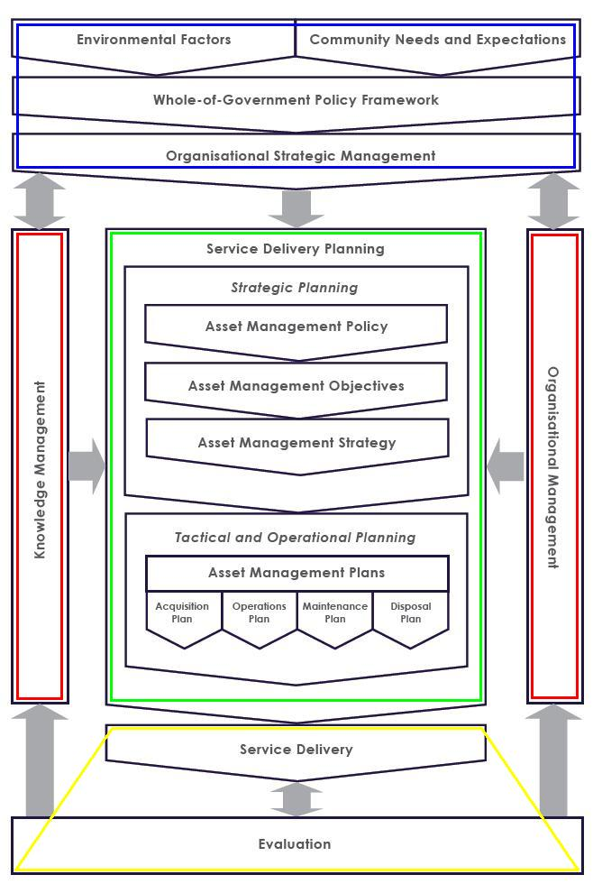
Integrated Strategic Asset Management Framework
The ISAM Framework maps out the processes of asset management
At the top are the external functions that provide context for asset management, such as community consultation (in Blue)
At the centre are the ‘core’ processes involved in planning, such as the development of strategies (in Green)
At the bottom are the recursive processes of service delivery and evaluation (in Yellow)
On either side are knowledge management and organisational management (in Red), responsible for coordinating the processes of asset management

Slide 4
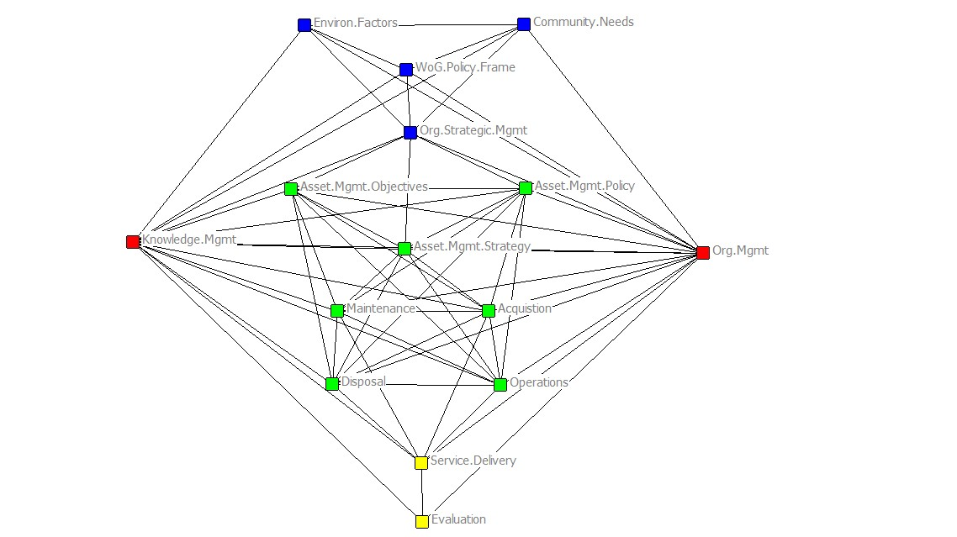
Network Analysis
The processes of the ISAM framework are presented here as a network map
Each node represents a coordinator for each of the functions of asset management
The ties between the nodes are the relationships that must exist for efficient service delivery
The network map provides a blueprint for an ‘ideal’ model for organisations to use in strategic asset management
The aim is to structure organisational charts and processes in the most efficient manner possible for service delivery

Slide 5
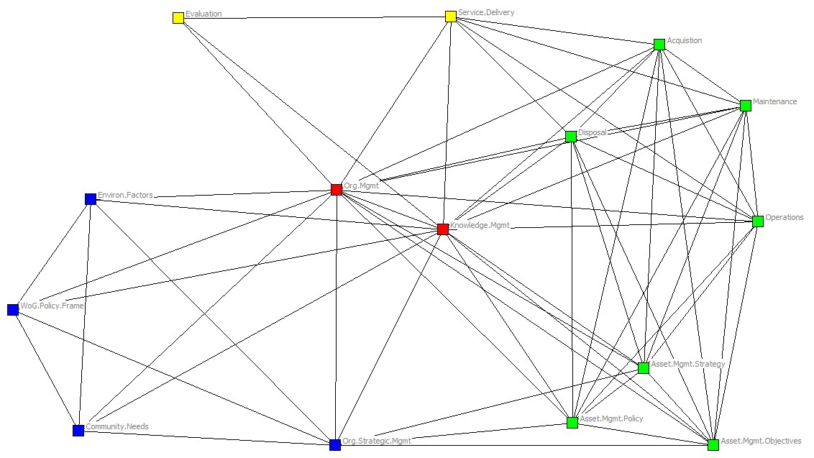
The ISAM Network
This is a ‘network centred’ representation of an ideal model for asset management.
This diagram is an ‘ideal’, in which all functions are clearly defined and integrated.
The network data can be drawn from organisation charts, reporting lines and position descriptions.
Deviations from this ideal model can be used to diagnose deficiencies and redundancies in the existing processes of asset management within a company, or around a specific project.

Slide 6
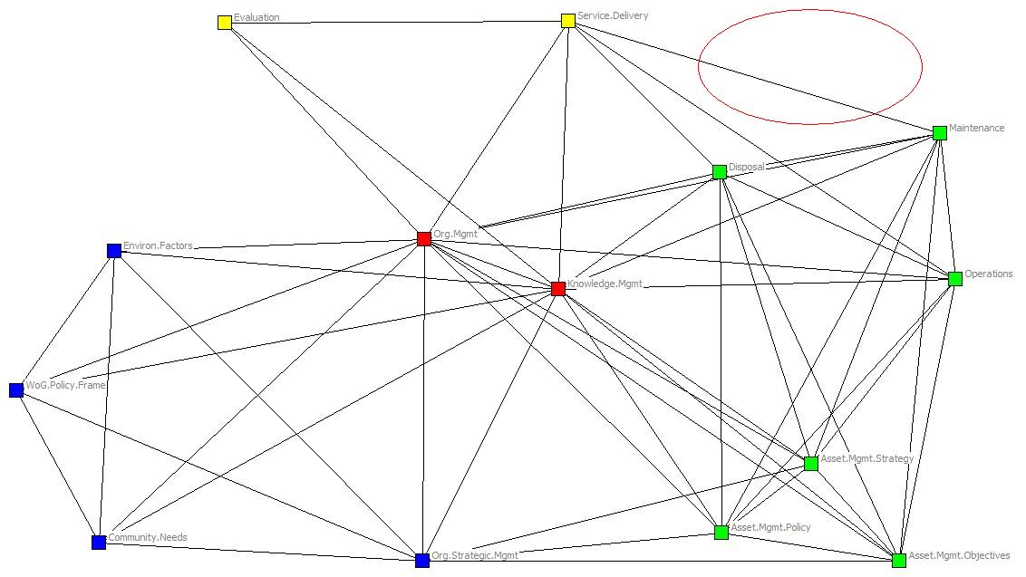
Diagnostic - Missing nodes
Functions that are not defined within the organisation will be absent from the network.
In this example the “Acquisitions Planning” role is missing from the top right hand corner of the network.

Slide 7
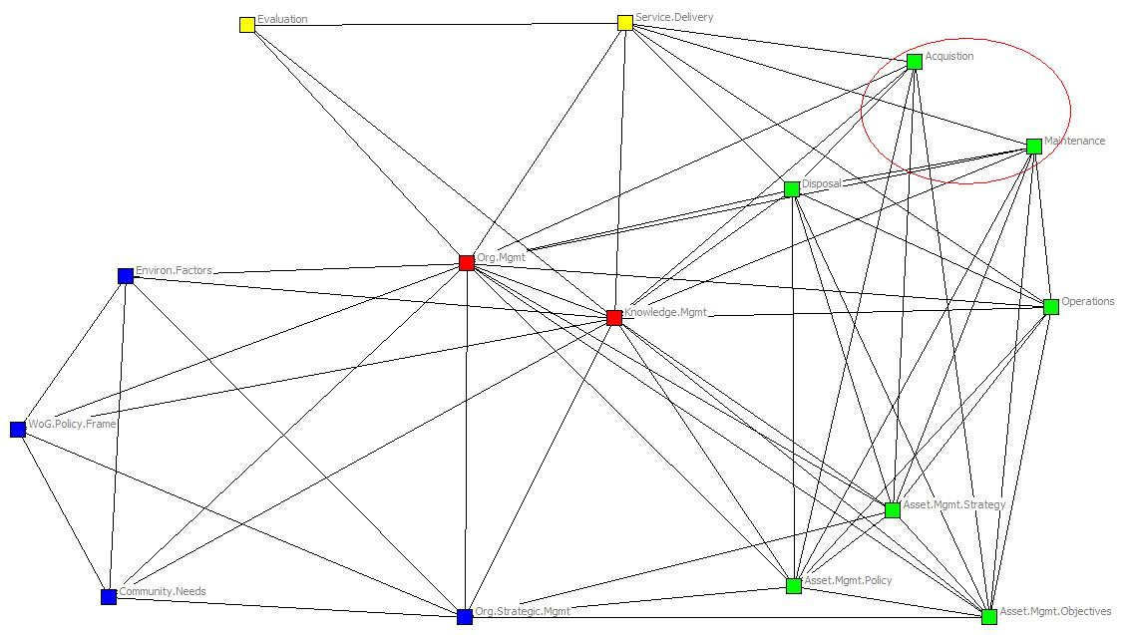
Diagnostic - Missing links
Those networks that are not fully integrated, where the different functions are not connected, will be missing the links between them.
The links between “Acquisitions Planning” and both “Operations Planning” and “Maintenance” in the top right hand corner are missing.
The lack of these connections make it harder for these functions to co-ordinate or share information.

Slide 8
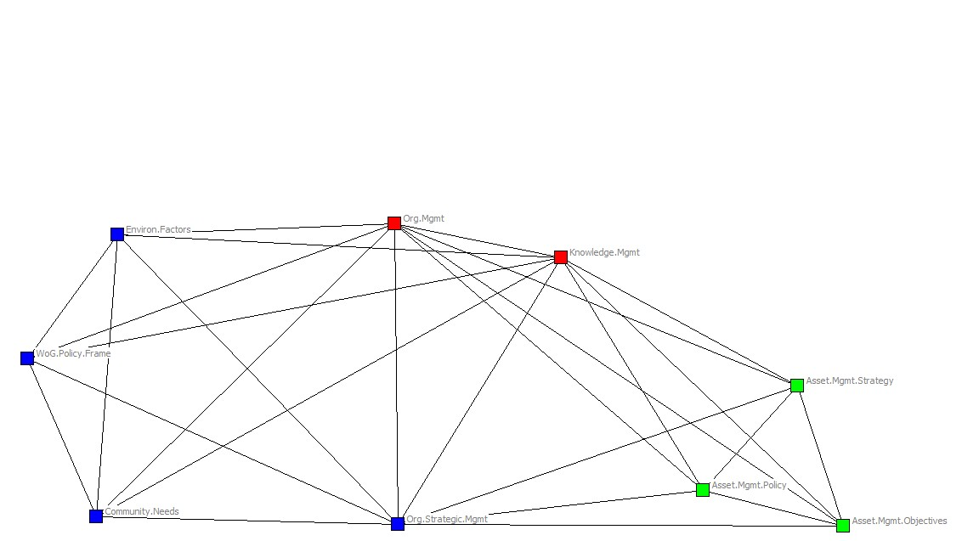
Diagnostic - Incomplete networks
Asset management is an extended process that covers the life of the asset.
Organisations with assets in the early stages of development may not have identified all of the necessary people responsible for later functions.
In this instance the strategic planning functions are undefined, as are the service delivery and evaluation functions.

Slide 9
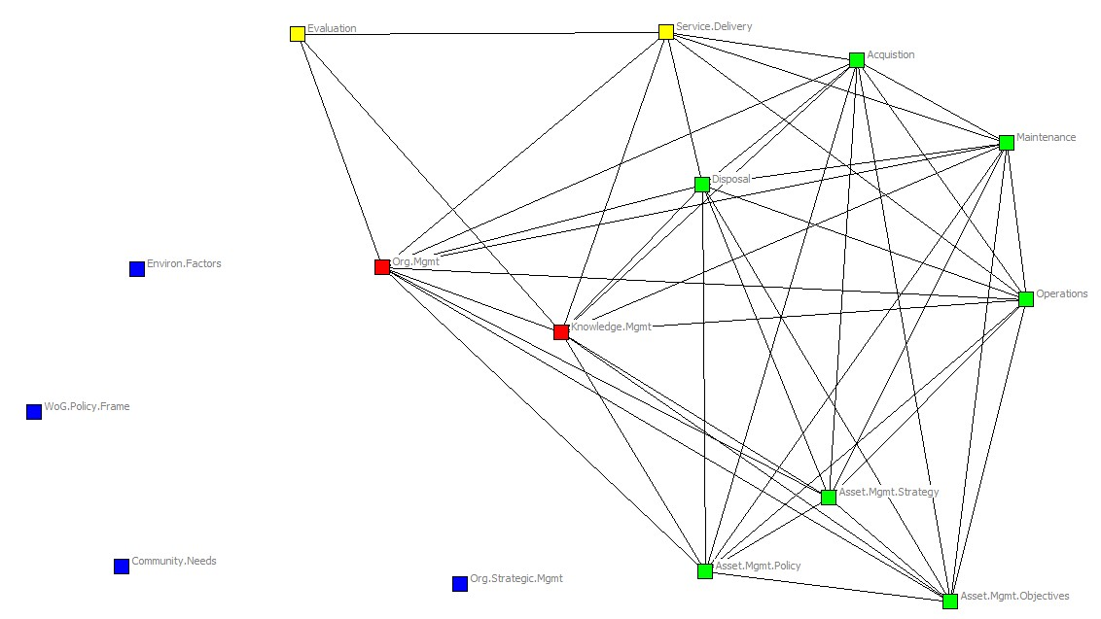
Diagnostic - Network fragmentation
The long term management of assets can result in the disconnection of functions crucial in earlier stages of development.
In this instance the functions responsible for external consultation and policy development are no longer connected with the network.
The loss of these connections can be problematic when there are changing factors that need to be considered in the ongoing management of the asset.

Slide 10
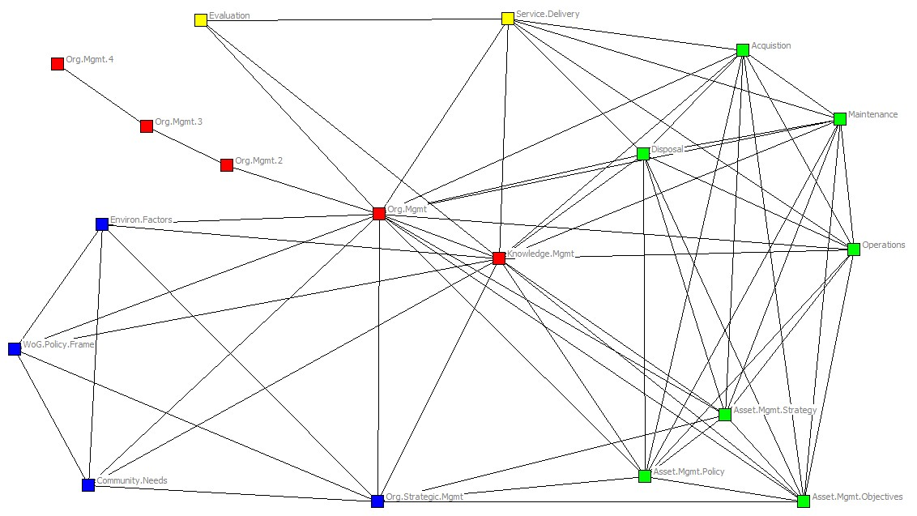
Diagnostic - Multiple Chains
An important aspect of the integration of these functions is the centralisation of the roles into clearly defined positions.
When important functions are removed from the network, the length of time it takes for information to be disseminated increases as it passes through chains.

Slide 11
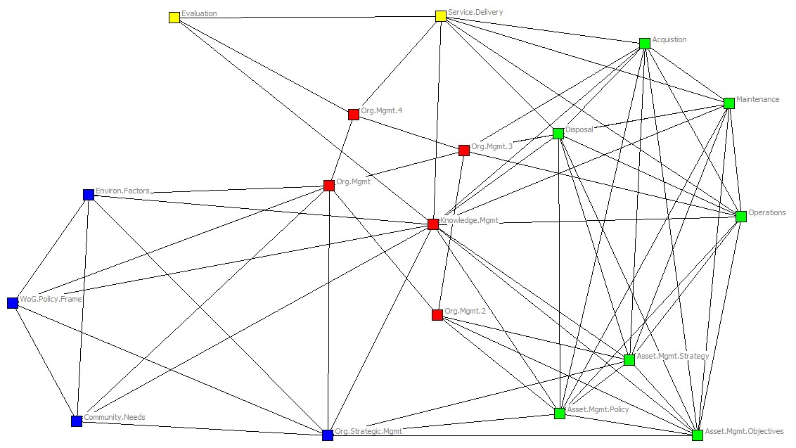
Diagnostic - Multiple Connected Nodes
Ideally each of the functions in the network are embodied in a single position.
In this example there are multiple asset managers responsible for various sections of the network, rather than having the function located in a central role.
Network structures such as these require a high degree of coordination between the roles in order to function effectively.

Slide 12
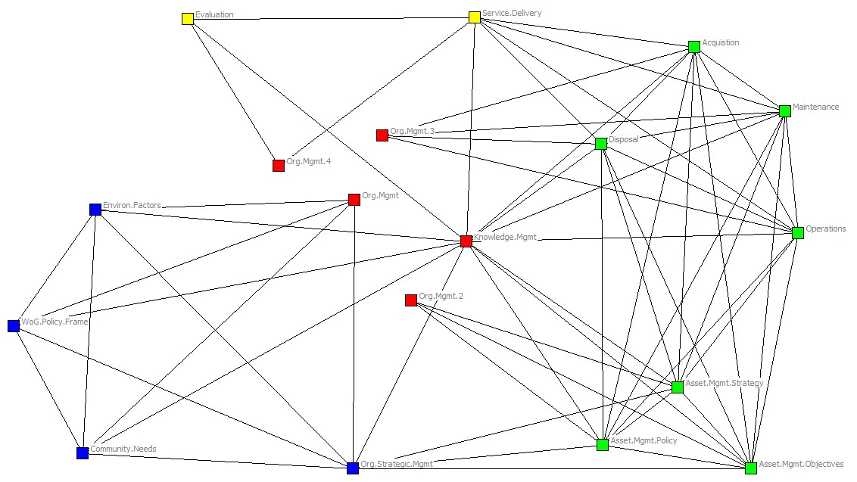
Diagnostic - Multiple Unconnected Nodes
More problematic is the scenario in which a function is embodied in multiple nodes that are unconnected.
In this example the asset managers responsible for different sections of the network are not able to coordinate directly.

Slide 13
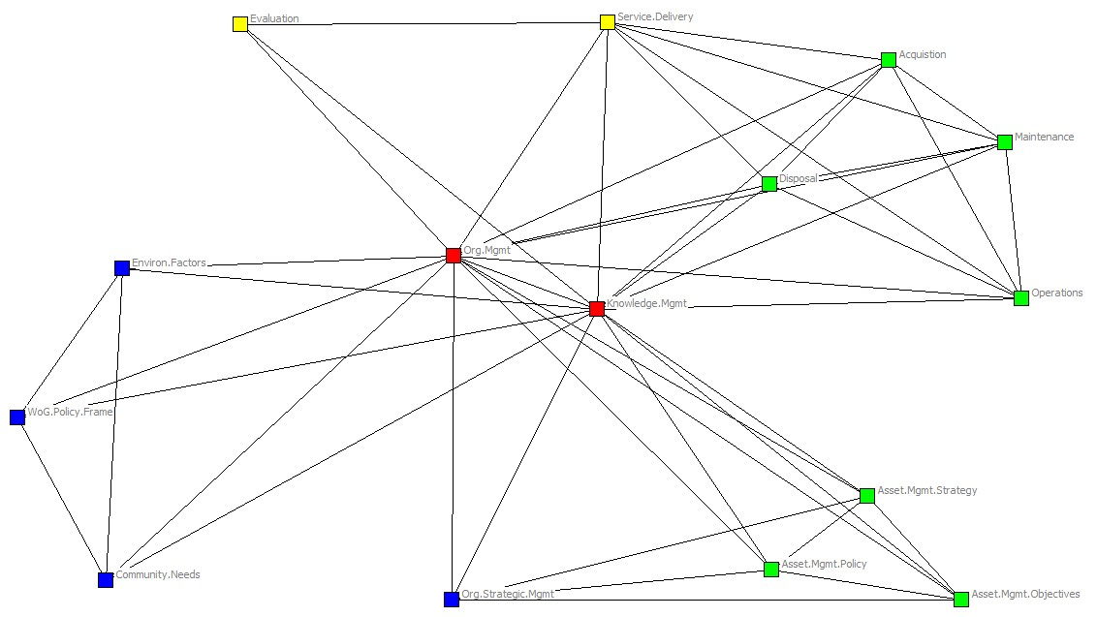
Diagnostic – Network Segregation
When groups of functions are not fully integrated the network becomes segregated into silos.
The network paths in this example are concentrated through asset management and knowledge management, doubling the distance that information must travel and potentially degrading the quality as it becomes relayed second hand.

Slide 14
References

