Slide 1
Social Network Analysis
Session 1
Introduction and Research Basics

Slide 2
Course Overview
Session 1: Social Network Analysis
An introduction and grounding in the basics
Session 2: Organisational Network Analysis
Networks as metaphor, and organizational metrics
Session 3: Organisational Process Mapping
Process flow charts as networks, diagnosis
Session 4: Strategic Networking
Network building and use

Slide 3
Session 1 Overview
Introduction and History of SNA
Graph theory, anthropology, sociology
Mapping a network
Social network metrics
Homophily, clusters, social capital
Analysing an egocentric network

Slide 4
Defining Social Network Analysis
At its simplest a network can be considered a ‘set of relations’.
“A social network is a structure composed of a set of actors, some of whose members are connected by a set of one or more relations” (Knoke and Yang 2008)

Slide 5
Features of SNA
SNA is motivated by a structural intuition based on ties linking social actors
Grounded in systematic empirical* data
Draws heavily on graphic imagery
Relies on the use of mathematical and/or computational model (Freeman 2004: 3)

Slide 6
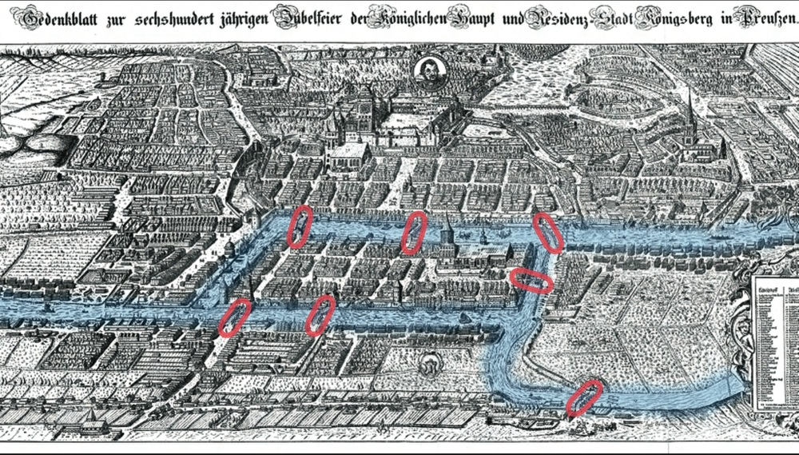
A brief history: Königsberg

Slide 7
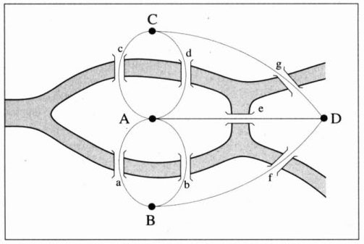
Euler’s solution

Slide 8
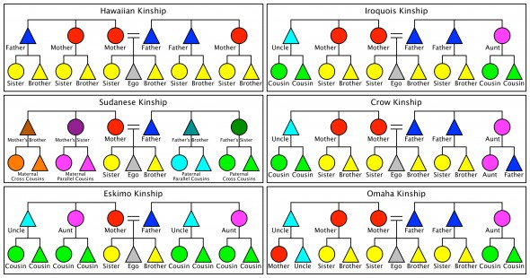
Anthropology

Slide 9
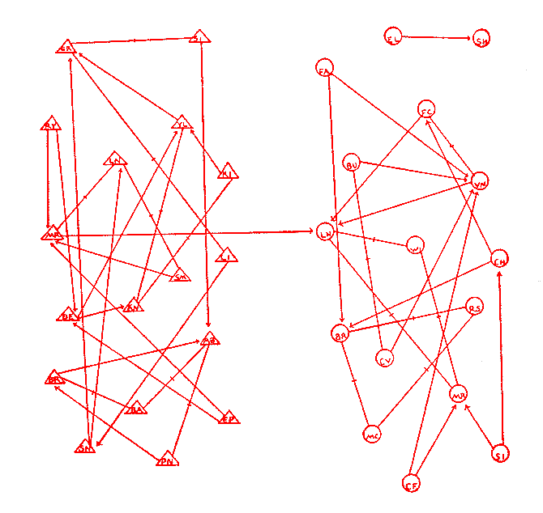
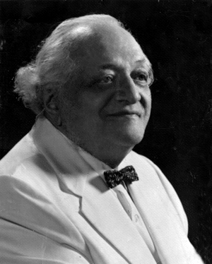
Jacob L. Moreno

Slide 10
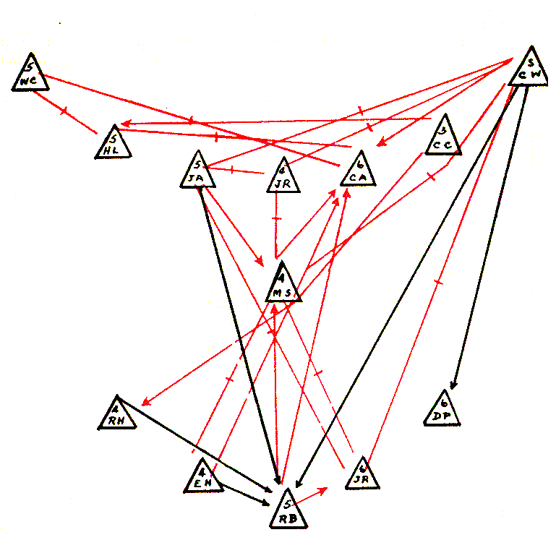
Sociograms
“A process of charting has been devised by the sociometrists, the sociogram, which is more than merely a method of presentation. It is first of all a method of exploration. It makes possible the exploration of sociometric facts. The proper placement of every individual and of all interrelations of individuals can be shown on a sociogram. It is at present the only available scheme which makes structural analysis of a community possible.” (Moreno 1953, pp. 95-96)

Slide 11
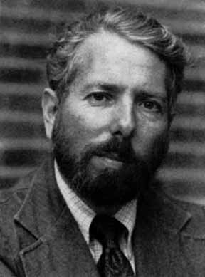
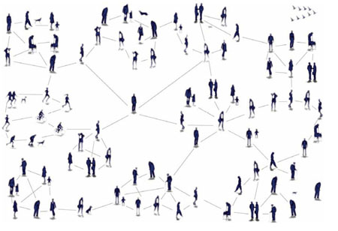
Stanley Milgram

Slide 12
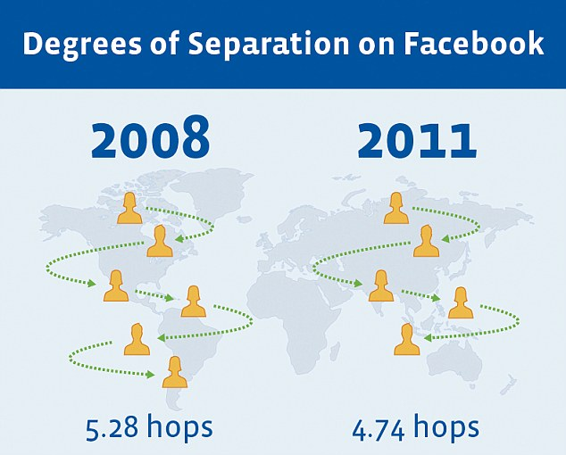
Six degrees of separation
http://www.facebookstories.com/stories/1574/interactive-mapping-the-world-s-friendships#color=continent&story=1&country=AU

Slide 13
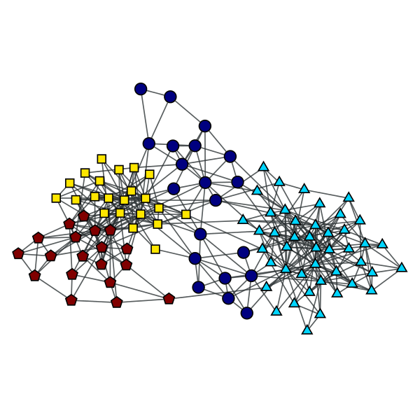
Harrison White

Slide 14
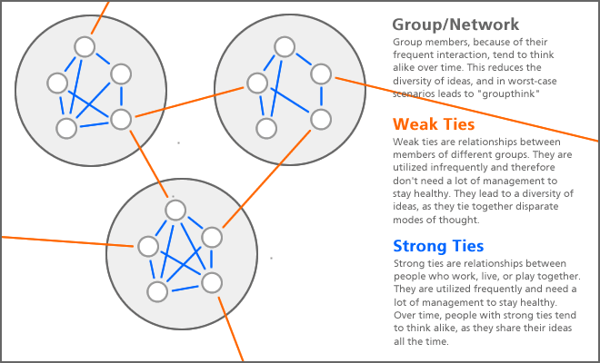
Mark Granovetter

Slide 15
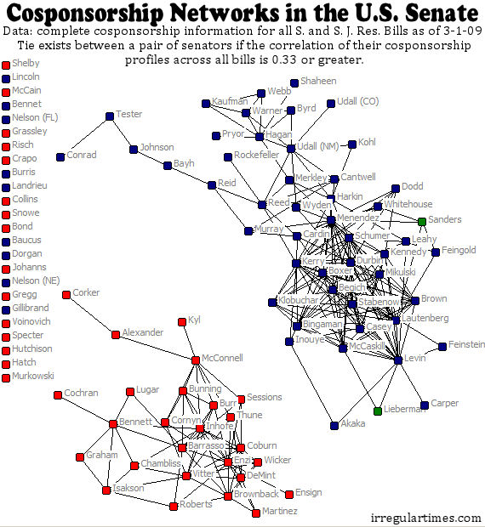
Sociometry
Sociometry is the study of bounded groups or “whole networks”.
Boundaries are set usually by relation (connection to other members) or association (sharing a quality).

Slide 16
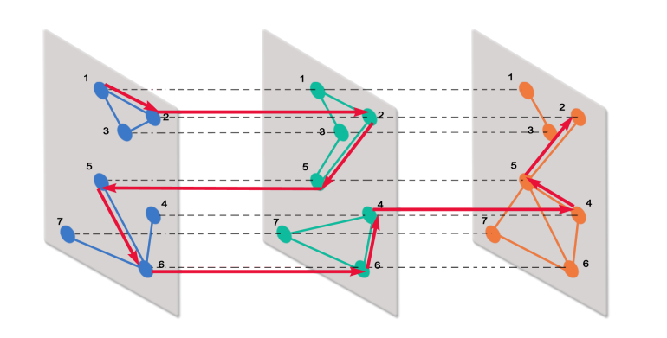
Multiplexity
Social network analysts suppose that multiplex relations are likely to foster reciprocity, trust, commitment, reputation, interdependence, and strength.

Slide 17
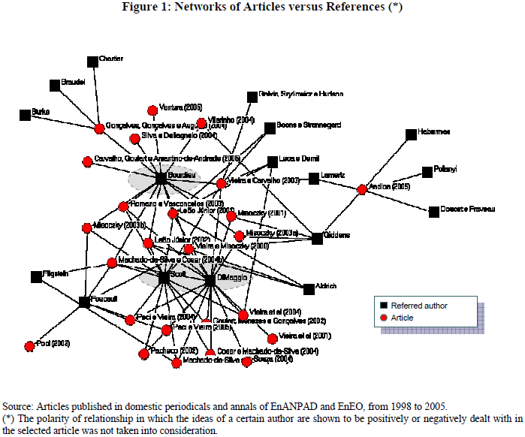
2-mode
A (2-dimensional) matrix is said to be 2-mode if the rows and columns index different sets of entities
Networks are formed through affiliation and association

Slide 18
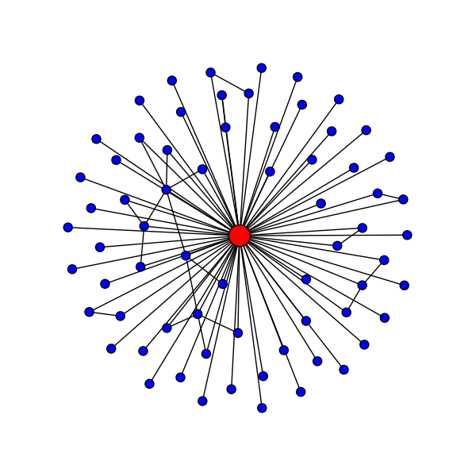
Egocentric
Egocentric research focuses on an individual’s relations to others
Relationships are defined by the participant, in relation to the participant

Slide 19
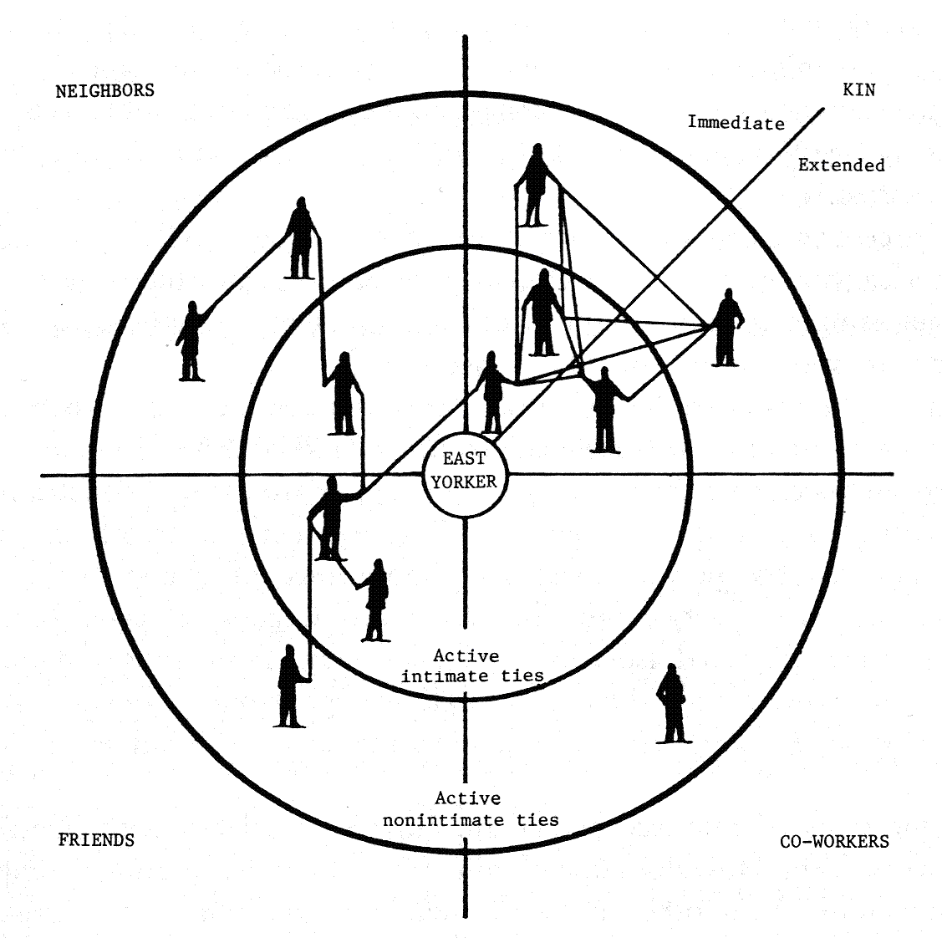
Egocentric
Primarily collected through interviews
Name generators:
Single
Multiple (e.g. Ronald S. Burt)

Slide 20
Map Your Own Egonet
Write your name on a post-it and put it in the centre of the template
“Who is important to you?” – Using the post-it notes write down the names of the people who are important or close to you
Using the template, situate these people according to how they are related to you and how close they are to you
Fill in the connections between everyone (except yourself)

Slide 21
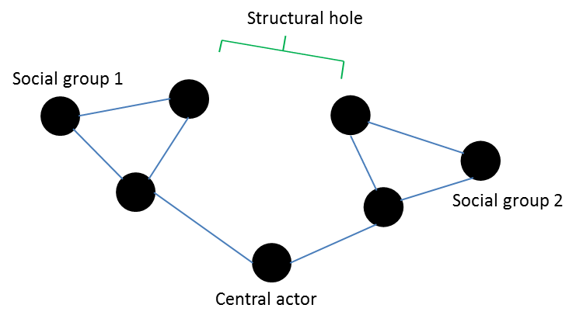
Social capital
The OECD defines social capital as 'networks, together with shared norms, values and understandings which facilitate cooperation within or among groups'

Slide 22
Homophily
Homophily is the tendency for people to associate with those who are like themselves in one form or another (Lazarsfeld and Merton 1948, McPherson, Smith-Lovin and Cook 2001)

Slide 23
Types of Homophily
Status homophily
Age, gender, race, ethnicity
Occupation, education
Class
Value homophily
Morals, ethics, religious beliefs
Political affiliation
Climate deniers, anti-vaxxers, conspiracy theorists

Slide 24
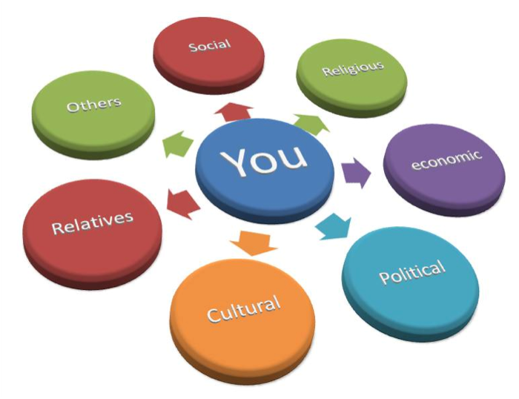
Social capital
Collected through surveys and interviews
Resource generator (Van der Gaag and Snijders 2005)
Position generator (Lin, Fu & Hsung 2001)

Slide 25
Types of Social Capital
Financial aid
Material support
Moving house, watering plants, fixing a bike
Emotional support
Intellectual knowledge
Financial advice, legal advice, professional knowledge

Slide 26
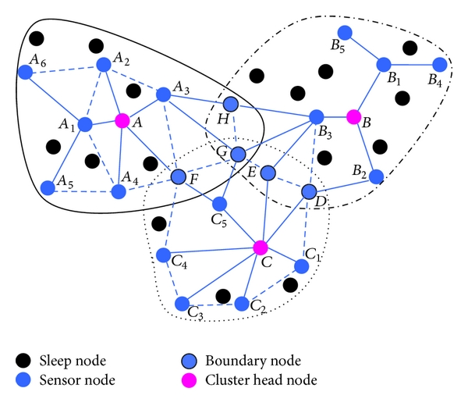
Cluster Analysis
Finds the ‘groups’ in the network
Boundaries can be defined along any lines
Smallest cluster is 3 people (triad)
Can be ‘loose’ or ‘tight’ knit, can overlap
Clusters promote cohesion
Groups can also be exclusive, and/or secretive

Slide 27
Types of Clusters
Spatially defined
Work units, work places
Organisations
Neighbourhoods, churches, schools, frequently visited places and spaces
Relationally defined
Shared interests, shared history
Usually relationships of choice rather than circumstance
Often develop out of spatially defined relationships

Slide 28
Analysing Your Network
Clusters: why are the people in your network grouped as they are? (Name the groups)
Homophily: how alike are the people connected together? In what ways? (Code the people and connections)
Social capital: what help could you expect from the people in your network? How likely are you to draw upon that capital?

Slide 29
Organisational Network Analysis
Session 2

Slide 30
Session 2 Overview
Networks as metaphor
Internal and external boundaries
Mapping an organisational network
Organisational network metrics
Structural holes, flows, brokerage, strength of weak ties
Analysing an organisational network

Slide 31
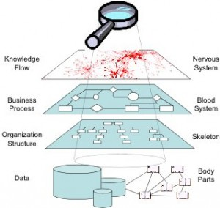
Networks as metaphor
Networks are the connections between the individuals in an organisation
The connections aren’t constrained by organisational structure
The network encompasses all forms of interpersonal connections, from professional to intimate

Slide 32
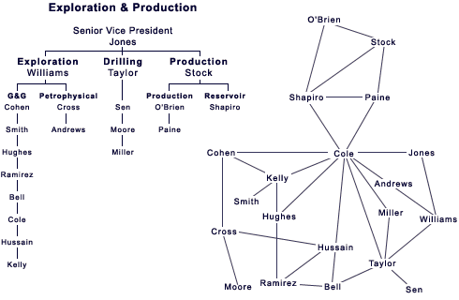
Translating network structure

Slide 33
Advantages
Identify core personnel (often mid-level)
these people may be highly influential, or bottlenecks in the network
Identify peripheral personnel
may have skills that are underutilised, lack engagement or are excluded from the network
Identify sub-groups and disconnects (silos)
groups that are cliquey, poorly connected (perhaps through upper management), or not connected to the rest of the organisation

Slide 34
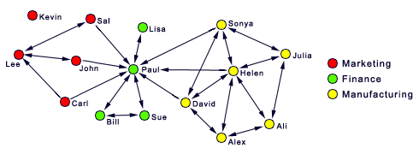
Tracing the network
Connections in organisational networks are likely to be more dense around organisational units
It should be possible to trace the hierarchy of an organisation within the network
Connections are not necessarily reciprocal, if one person is reporting to another

Slide 35
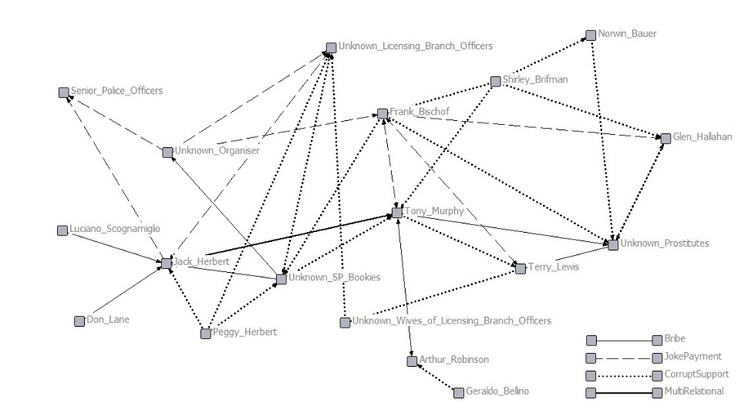
Tracing the network (cont.)
Many relationships do not expire
Relationships can be negative
Relationships can be secretive or hidden

Slide 36
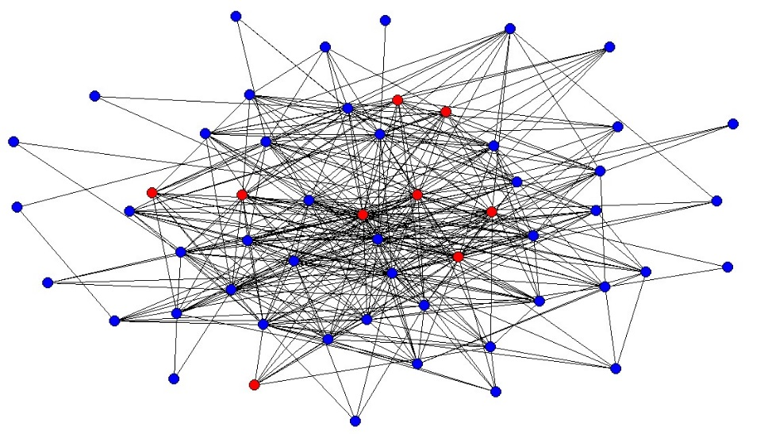
Internal vs External Networks
The same principles apply to the connections between individuals in different organisations
Inter-organisational networks are facilitated by individuals making informal connections as much as formal relationships

Slide 37
Why inter-organisational networks?
Outsourcing
Increasing size of effect without increasing organisation size
Cooperation, coordination, collaboration

Slide 38
Map your organisational network
In the same way that you mapped your egonet, map out your organisational network
Organisational unit
Hierarchy (above and below)
Other people in your organisation you know
Use the length of the template for hierarchy, the width of the template for closeness
Identify the external stakeholders that you connect with (outside the internal walls)
To your best ability add in those individuals who are significant in your network that you are not directly connected to
Draw in the relationships that you are certain of

Slide 39
Structural Holes
Structural holes occur when an individual ‘bridges’ across two otherwise unconnected groups
The ‘central actor’ has an advantage in that they have access to resources that others in their network do not

Slide 40
Brokerage
Brokerage

Slide 41
Structural Equivalence

Slide 42
The Strength of Weak Ties

Slide 43
Global Metrics
Global metrics require considerable computational power, and ‘whole’ network data
Density is the proportion of connections that exist out of all possible connections
Average degree is the average number of connections that each node has to their partners

Slide 44
Global metrics (cont.)
Degree centrality is a measure of how centralised the network is around a small proportion of nodes
Betweenness measures how frequently the same nodes appear on the paths between nodes
Closeness measures how well connected the network is on average
The cohesion measures indicate how tight knit the network is, in sub-groupings and as a whole

Slide 45
Analyse your organisational network

Slide 46
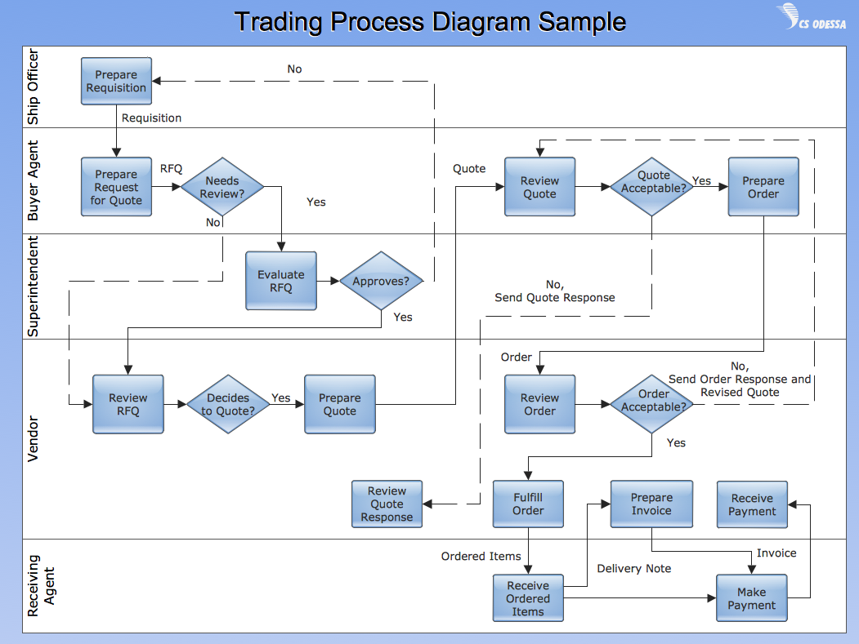
For tomorrow
Tomorrow’s first session involves organisational process flow charts like these →
Given the focus on real world examples, it would be very helpful if you had one of these from your own area for use tomorrow
No engineering flow charts!

Slide 47
Organisational Process Mapping
Session 3

Slide 48
Session 3 Overview
Process flow charts
The embodiment of organisational processes
Mapping a process network
Diagnosing process network issues
Using process flow models and
Analysing process network

Slide 49
Process flow
“A method of visually documenting the stages involved in performing a certain business procedure. A type of process flow popular among business managers might take the form of flow charts that show inputs or information requests, followed by each of the steps required to create deliverable outputs such as products or services from the inputs”¹
http://www.businessdictionary.com/definition/process-flow.html.

Slide 50
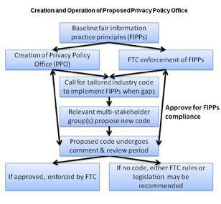
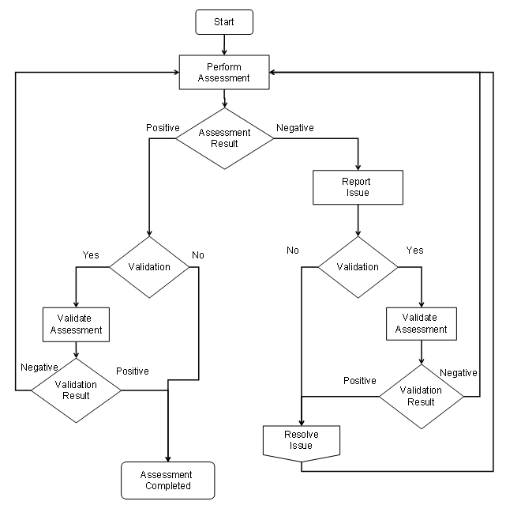
Process flow examples

Slide 51
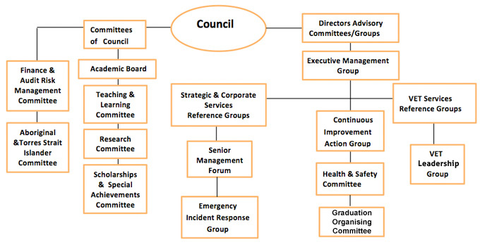
The process flow embodied
The process “flow” is the flow of information
The processes in an organisational flow chart require human agency
Each node in the network may represent numerous people
Multiple nodes in a network might be the responsibility of one person

Slide 52
Problems with process flows
Organisational process flows are often designed to fit into existing organisational structures, with all the problems that entails
Organisational process flows may not be updated when organisational structures are altered
The individuals responsible for the processes may not be clearly identified or identifiable
The processes involved are not necessarily linear or isolated, but require coordination with other aspects in order to function properly

Slide 53
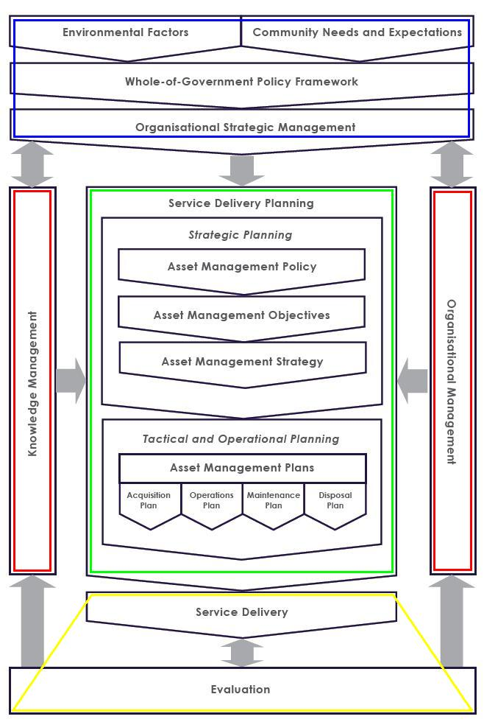
Integrated Strategic Asset Management Framework
The ISAM Framework maps out the processes of asset management
At the top are the external functions that provide context for asset management, such as community consultation (in Blue)
At the centre are the ‘core’ processes involved in planning, such as the development of strategies (in Green)
At the bottom are the recursive processes of service delivery and evaluation (in Yellow)
On either side are knowledge management and organisational management (in Red), responsible for coordinating the processes of asset management

Slide 54
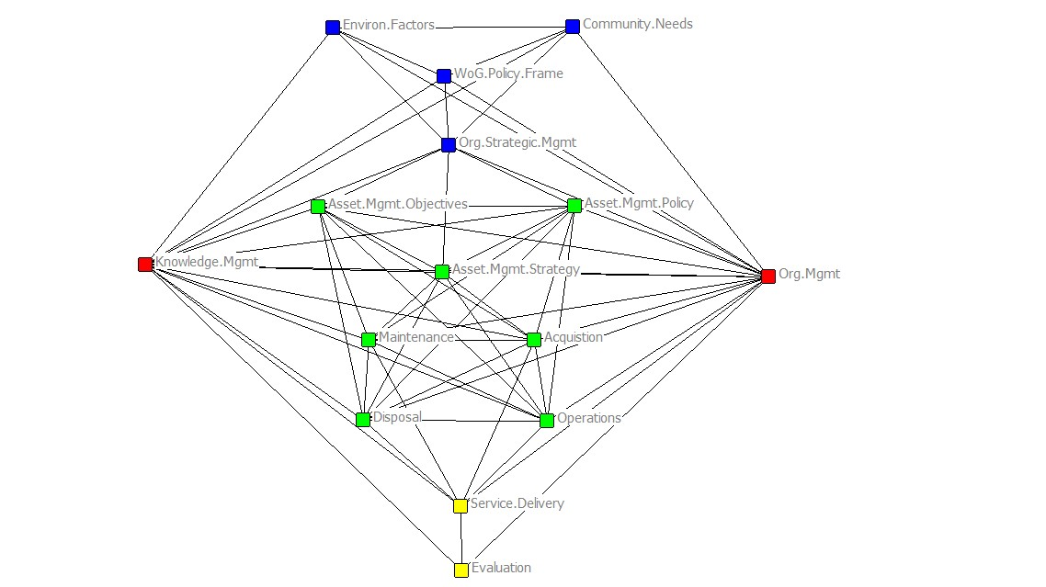
Network Analysis
The processes of the ISAM framework are presented here as a network map
Each node represents a coordinator for each of the functions of asset management
The ties between the nodes are the relationships that must exist for efficient service delivery – particularly where individuals need to coordinate their areas but aren’t necessarily in the same flow of information
The network map provides a blueprint for an ‘ideal’ model for organisations to use in strategic asset management
The aim is to structure organisational charts and processes in the most efficient manner possible for service delivery
Notes:
Things to add here:
Explanation of why network analysis is important, discussion of structure and position – demonstrates disconnects, strengths and weaknesses of the network connections

Slide 55
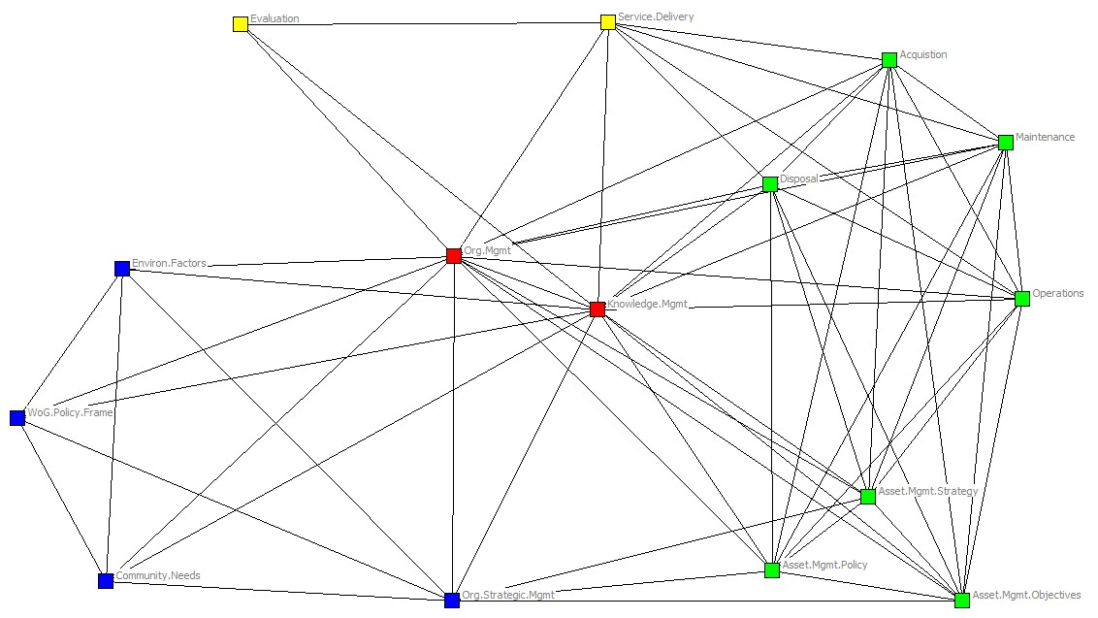
The ISAM Network
This is a ‘network centred’ representation of an ideal model for asset management.
This diagram is an ‘ideal’, in which all functions are clearly defined and integrated.
The network data can be drawn from organisation charts, reporting lines and position descriptions.
Deviations from this ideal model can be used to diagnose deficiencies and redundancies in the existing processes of asset management within a company, or around a specific project.

Slide 56
Map your own process network
Using your own area of expertise, draw up a process map showing the flow of information
Identify those steps that require a human being to either employ their knowledge, or to make a decision
Link together those nodes based on the flow of information
Link together those nodes that need to coordinate their efforts in order to successfully fulfil their function

Slide 57
The ISAM Network
This is a ‘network centred’ representation of an ideal model for asset management.
This diagram is an ‘ideal’, in which all functions are clearly defined and integrated.
The network data can be drawn from organisation charts, reporting lines and position descriptions.
Deviations from this ideal model can be used to diagnose deficiencies and redundancies in the existing processes of asset management within a company, or around a specific project.

Slide 58
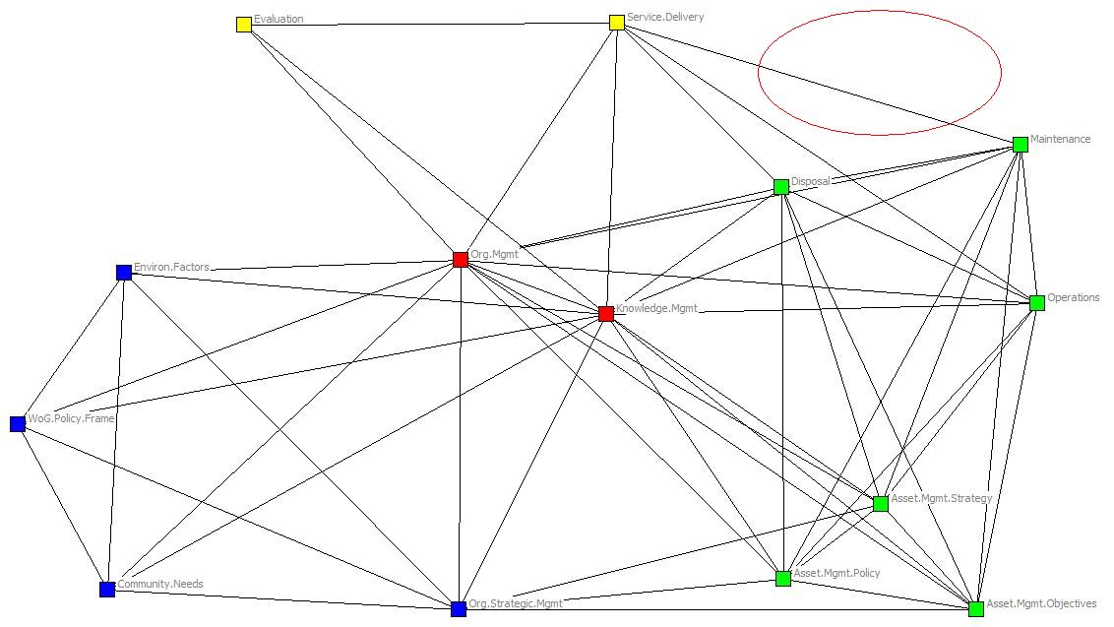
Diagnostic - Missing nodes
Functions that are not defined within the organisation will be absent from the network.
In this example the “Acquisitions Planning” role is missing from the top right hand corner of the network.

Slide 59
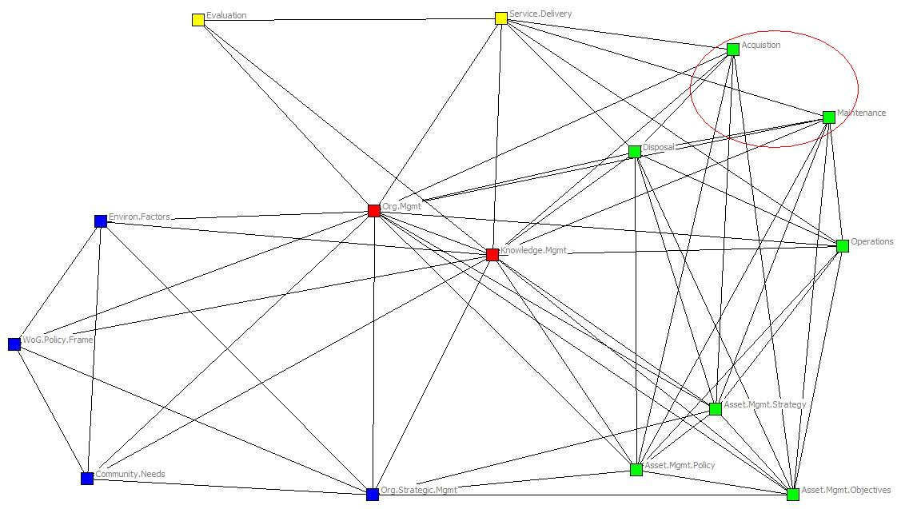
Diagnostic - Missing links
Those networks that are not fully integrated, where the different functions are not connected, will be missing the links between them.
The links between “Acquisitions Planning” and both “Operations Planning” and “Maintenance” in the top right hand corner are missing.
The lack of these connections make it harder for these functions to co-ordinate or share information.

Slide 60
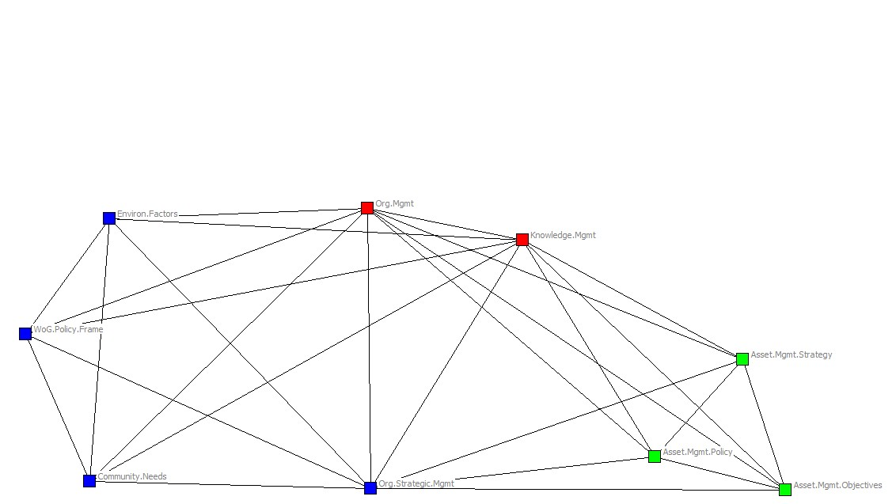
Diagnostic - Incomplete networks
Asset management is an extended process that covers the life of the asset.
Organisations with assets in the early stages of development may not have identified all of the necessary people responsible for later functions.
In this instance the strategic planning functions are undefined, as are the service delivery and evaluation functions.

Slide 61
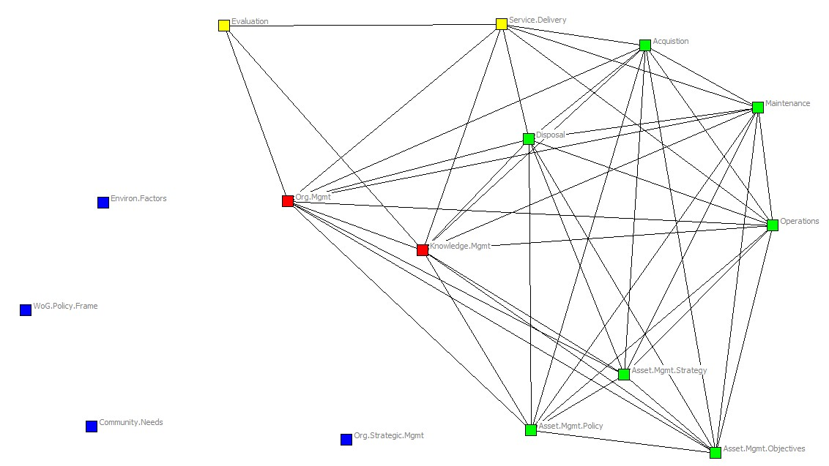
Diagnostic - Network fragmentation
The long term management of assets can result in the disconnection of functions crucial in earlier stages of development.
In this instance the functions responsible for external consultation and policy development are no longer connected with the network.
The loss of these connections can be problematic when there are changing factors that need to be considered in the ongoing management of the asset.

Slide 62
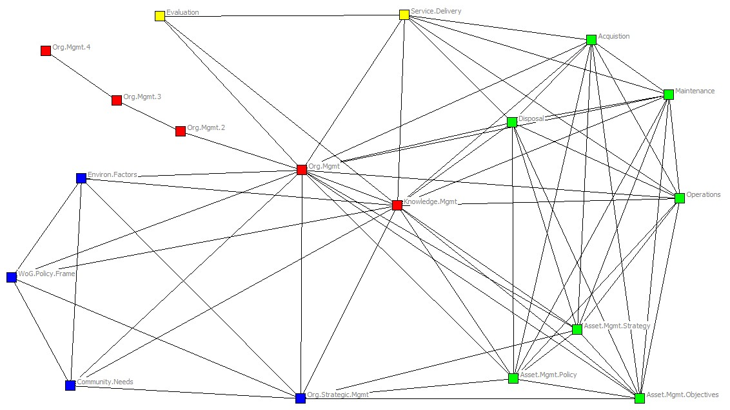
Diagnostic - Multiple Chains
An important aspect of the integration of these functions is the centralisation of the roles into clearly defined positions.
When important functions are removed from the network, the length of time it takes for information to be disseminated increases as it passes through chains.

Slide 63
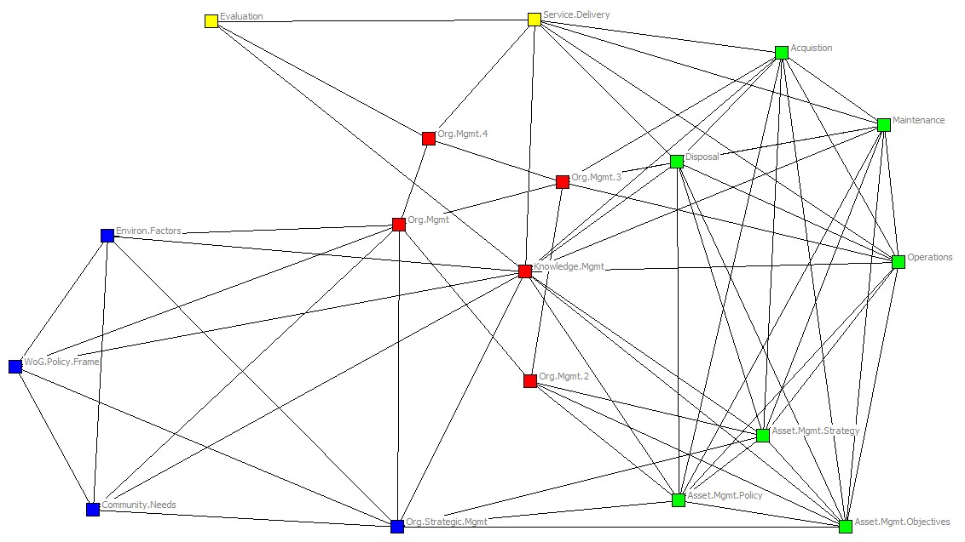
Diagnostic - Multiple Connected Nodes
Ideally each of the functions in the network are embodied in a single position.
In this example there are multiple asset managers responsible for various sections of the network, rather than having the function located in a central role.
Network structures such as these require a high degree of coordination between the roles in order to function effectively.

Slide 64
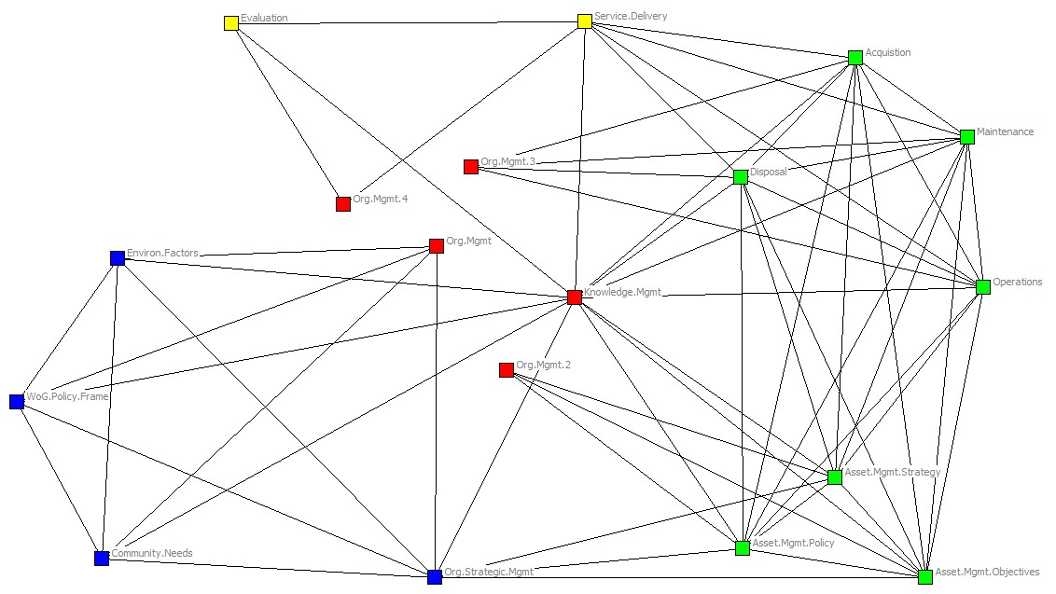
Diagnostic - Multiple Unconnected Nodes
More problematic is the scenario in which a function is embodied in multiple nodes that are unconnected.
In this example the asset managers responsible for different sections of the network are not able to coordinate directly.

Slide 65
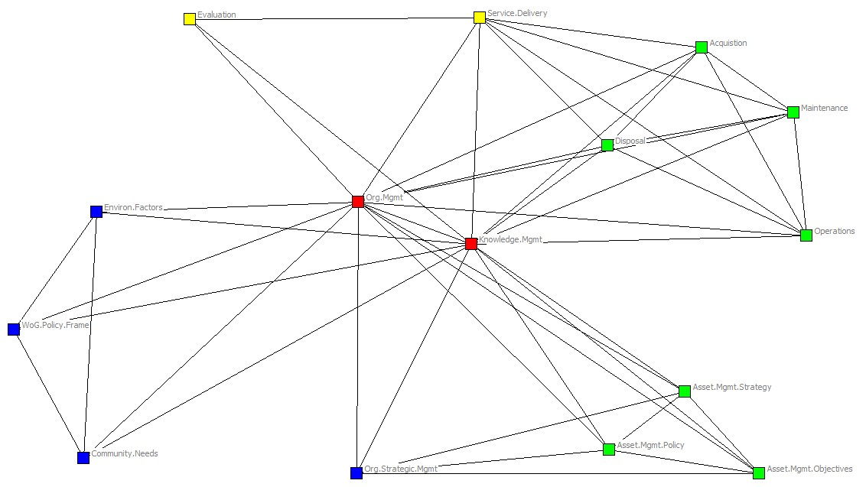
Diagnostic – Network Segregation
When groups of functions are not fully integrated the network becomes segregated into silos.
The network paths in this example are concentrated through asset management and knowledge management, doubling the distance that information must travel and potentially degrading the quality as it becomes relayed second hand.

Slide 66
Real world application of ISAM network model
The analysis can be used to:
Identify and define the functions of asset management within an organisation;
Identify areas of disconnect, gate keeping and silos;
Connect the functions of asset management into an efficient governance structure; and
Integrate and streamline the processes of asset management to maximise service delivery outcomes.

Slide 67
Analyse your organisational process map
Using your ideal model, map out how the real world processes function (to the best of your knowledge)
Compare the real world organisational process map to your ideal model – how do they differ?
How much of the differences between the two are because of your lack of knowledge?

Slide 68
Strategic Networking
Session 4

Slide 69
Session 4 Overview
Network building
Goal directedness and serendipity
The 3Cs model – Cooperation, Coordination and Collaboration
Trust, homophily, social capital, reciprocity
Final exercise

Slide 70
Network building
Networks are not static, they evolve and develop
The factors affecting network development are often external
Organisational structure
Location
Homophily

Slide 71
 | Serendipitous process dominant | Goal-directed process dominant
Underlying assumptions | No pre-existent goal. Network evolves through random variation, selection and retention process. | Teleological and instrumental. Actors share a goal. Network is formed to achieve this goal. Success is measured against this goal.
Typical network growth | Slower to form. Grows through dyadic ties. Long-lived, robust survival in times of change. | Fast to form around shared goals. Survival threatened by both success and failure. New goal discovery prolongs life span.
Structural dynamics | Decentralised structure with no single leader. Produces structural holes. Loose coupling. Diffuse boundary. Growth based on dyadic match. More likely to create sub-networks, over time. | Centralised structure with a leader: core-periphery. Minimizes structural holes. Tight coupling. Clear boundary. Growth based on eligibility. Less likely to survive sub-network formation.
Conflict | Sub-groups, each with internal solidarity, can survive in the same network. | If conflicts arise over goals, probable break-up of network.
Implications for individual actors | More diverse actors. Actors participate based on shared ties. Mobility through network links. Unexpected career change may occur. Emphasis on interpersonal trust at dyadic level. | More homogenous actors. Actors participate based on shared goals. Mobility across similar organisations. More predictable career path. Emphasis on network-wide trust.
Notes:
Kilduff, Martin and Wenpin Tsai, 2003, Social Networks and Organizations, Sage, Los Angeles.
Chapter 5, figure 5.1.

Slide 72
The 3Cs
The 3Cs are models of inter- and intra-organisational integration
Cooperation primarily focuses on sharing information and expertise
Coordination involves greater interdependence and alignment of resources towards shared goals
Collaboration requires strong and highly interdependent relationships, system level changes, ceding of autonomy

Slide 73
Cooperation
Low trust, unstable relations
Infrequent communication flows
Known information sharing
Adjusting actions
Independent/autonomous goals
Power remains with the organisation
Commitment and accountability to own agency
Relational time frame requirements are short term, can be entered into and developed quickly

Slide 74
Coordination
Medium trust, building upon prior relations
Structured communication flows
Project related and directed information sharing
Joint projects, joint funding, joint policy
Semi-independent goals
Power remains with organisations
Shared resources around project
Commitment and accountability to own agency and project
Relational time frame medium term – often based on prior projects

Slide 75
Collaboration
High trust, stable relations
Thick communication flows
Tactical information sharing
Systems change
Dense interdependent relations and goals
Shared power
Pooled, collective resources
Commitment and accountability to the network first
Relational time frame requirements are long term – 3 to 5 years

Slide 76
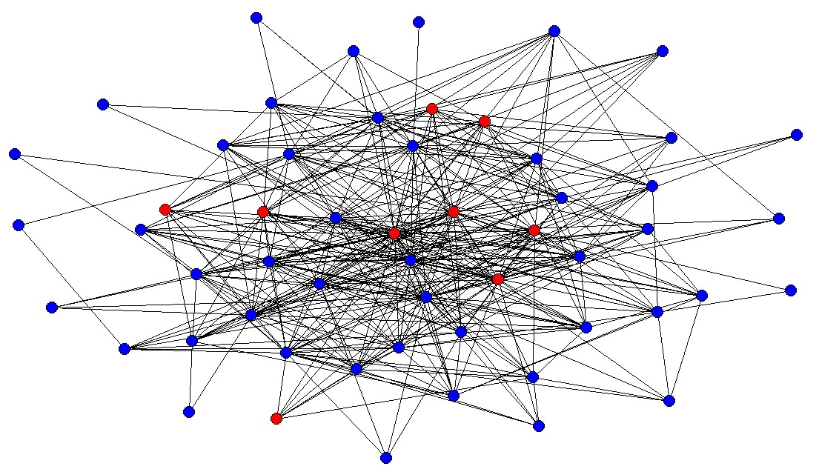
Townsville Homelessness Services 2011

Slide 77
How to select network partners
To what end are you building a network?
‘Trust, reciprocity and mutuality are the glue that binds’ (Powell 1990)
Homophily is not the best guiding principle – structural equivalence and structural holes
Social capital – what can you get out of a relationship?

Slide 78
Trust
Building trust requires time and a willingness to engage with partners
Reciprocity and mutuality underpin trust in a relationship, one-way relationships are unproductive

Slide 79
Developing your network

Slide 80
Assessing your network

Slide 81
Back in the real world
How are you going to use the network approach in your work?
Can you think of network partners that you should be connecting with?
Is there anyone you’ve met during this course whom you’d like to keep in contact with (including teachers)? Who might be able to help you with your current projects?

